Slide 1
BBConsulting
Clare Bohne • Sarah Golubski • Michael Kalmin • Matt Rubin • Evan Goss • Bobby Mulligan
Notes:
CLARE!
Company logo/Target logo

Slide 2
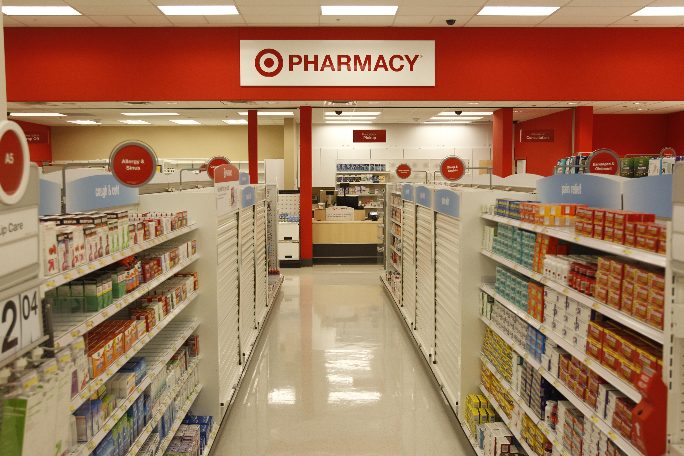
Target the Times
Notes:
CLARE!
Our campaign is designed to “Target the times”
-waiting in line
-bridging gap between generations of customers

Slide 3

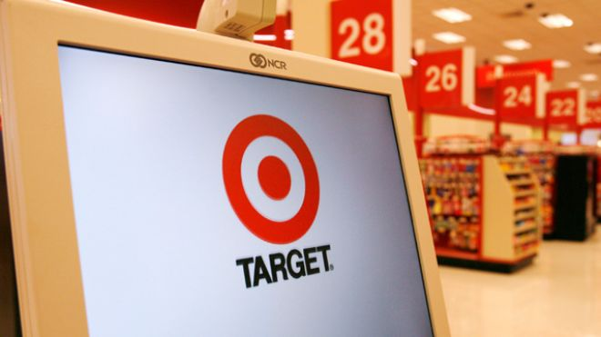
Welcome to
Notes:
CLARE!
Our solution to challenges Target Pharmacy is facing now.
Plan for Pharma-Booth: shorten wait time, convert existing guests to pharmacy users, attract new pharmacy users Your one stop for anything and everything Pharmacy

Slide 4
Meet Our Guests…
Notes:
SARAH!
introduce 3 characters
Edna, Kim, Chad
Although these 3 guests are different, they all have one thing in common…

Slide 5

Kim
Notes:
SARAH!

Slide 6
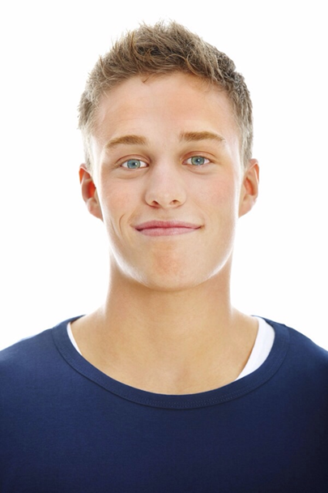
Chad
Notes:
MICHAEL
Chad is 1 of the 48 mil who will get health care due to affordale care act (Nytimes)
This will provide an influx of younger shoppers
According to Target executive, Dan Dumonsau, Target is not sure how it is going to approach the huge influx of new customers in the next few months. ACA provides an opportunity to grow Target’s new customer base. The Affordable Care act also brings the challenge of how all pharmacies will deal with the upcoming increase in demand
Our strategy will help Target accommodate this influx of new pharmacy users

Slide 7

1 of 48 Million
Notes:
MICHAEL

Slide 8

Edna
Notes:
MATT!
The 50+ segment of Boomers accounts for 100 million consumers (Marketing Charts)
Growing senior citizen population
90% of people 65+ use at least 1 prescription a month
65% take 3 per month
13% of US population is 65+, 88.5 Million expected by 2050
Target research report packet: 5,000 people turn 65 every day - this will account for a growth in older shoppers

Slide 9
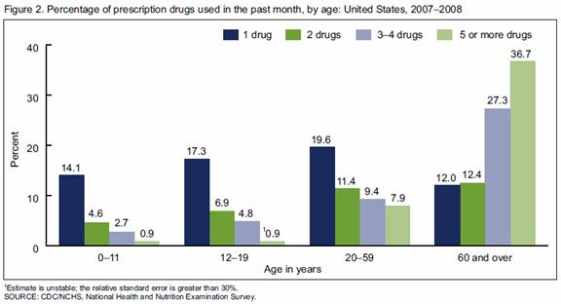
Opportunities
Notes:
MATT!
Presents new/wide opportunity for Target Pharmacy
Want to convert all existing guests to pharmacy guests, and introduce new shoppers to Target through pharmacy

Slide 10
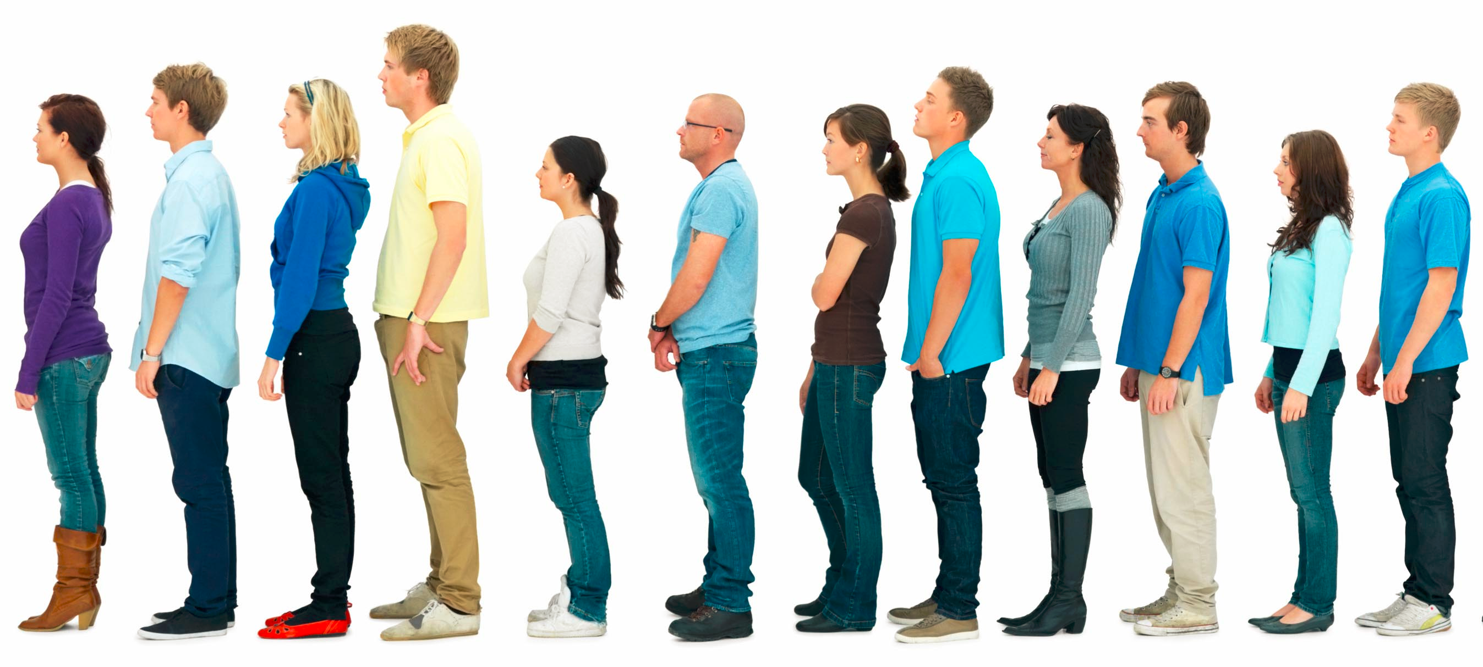
37 billion hours per year
Notes:
EVAN!
All hate waiting in line, wasting time and money
Essentials of Practical Management Science estimated that Americans wait in line for 37 billion hours per year
Major problem in pharmacy departments across the country

Slide 11
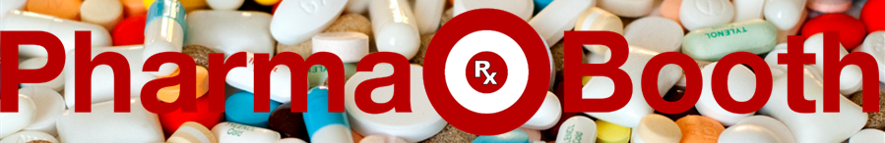
Notes:
EVAN! (pharma-booth photo should go here…)
Old: face-to-face pharmacy technician (high quality customer service)
Current: product exposure/marketing campaign (multi-task, in-store traffic)
New: technology (iPads, buzzers, convenience)

Slide 12
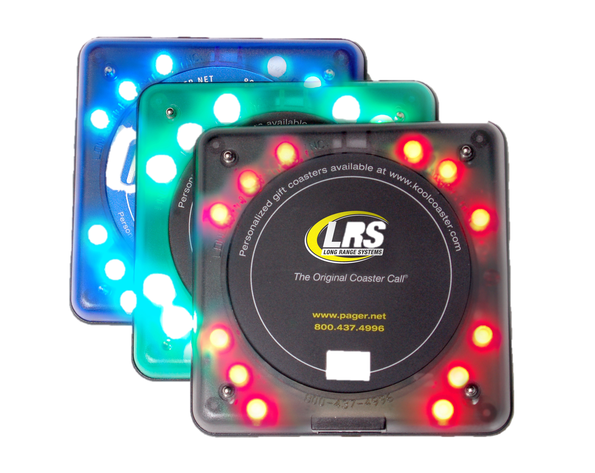
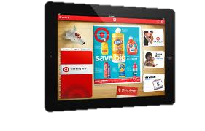
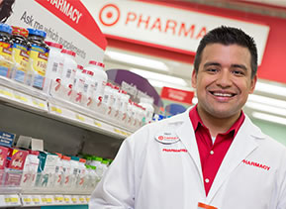
Bridging the Gap
Notes:
BOBBY!
Solving Target Pharmacy’s problem of convenience for each type of guest
-technology
-high quality face-to-face customer service
-accommodates every kind of pharmacy user from young to old

Slide 13
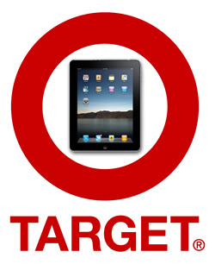
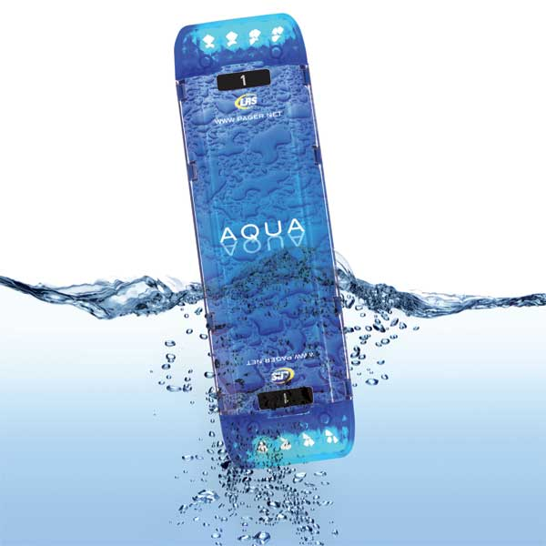
Technology
Notes:
MICHAEL!

Slide 14
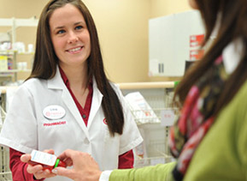
Face-to-Face Guest Service
Notes:
EVAN!
“Pharmacists lack time to engage guests”
“Service differentiates Target from competitors”

Slide 15
Our Implementation Timeline
Jan. 1, 2014 Local Marketing
Feb. 1 2014 First Pharma-Booth
July 1, 2014 All Great Lake Region
July 1, 2015 National Implementation
Notes:
MATT!!

Slide 16
Financials
Estimated Increase of 1 customer per hour
$37,880
Per Pharmacy Value Increase
This equals a 0.2% increase in market share and total value of $57.1 million
Notes:
BOBBY! (Fill this in with all your needed info)
Our estimate leads us to believe that Target Pharmacy will grow 0.2% in market share and increase revenue to $37,880 per store. Across all stores, this becomes a value after costs of $57.1 million.

Slide 17
Financials
Capacity Growth
Additional Sales
Lowered Risk

Slide 18
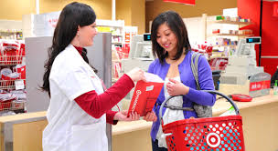
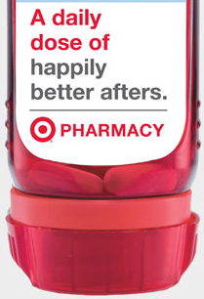
Creating the Time Saving Pharmacy
Increased Sales
Shorter lines
Notes:
CLARE!
Within several weeks of implementation, Pharma-Booth will successfully shorten pharmacy lines and increase department sales. The new pharmacy technician and iPad station will attract a large portion of the older and younger generations. The pager system and Pharma-Booth location will successfully encourage product exposure as well as sales within other departments. Within a few months, the success of Pharma-Booth shows that it’s ready to move into other stores.
SARAH!
Pharma-Booth is designed to shorten lines for the prescription counter, which in turn will mostly be used for face-to-face interactions between guests and staff, such as specific questions regarding medication. Pharma-Booth also works as an in-store marketing campaign that will convert existing Target guests to the pharmacy, as well as bring in new Target shoppers. Most importantly, Pharma-Booth highlights guests’ in-store experience, which will heighten traffic for Target Pharmacy and other Target departments too.
Our Pharma-Booth addresses the most common concern of any shopper, convenience, while confronting Target’s lack of a pharmacy specific marketing strategy. This will enhance Target Pharmacy’s reputation between guests as well as expose the Target Pharmacy brand to the general public.

Slide 19
Q&A

Slide 20

Germs

Slide 21
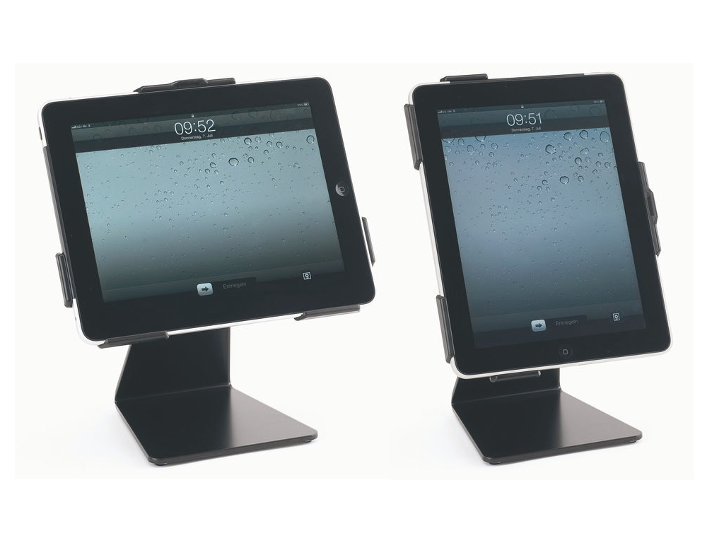
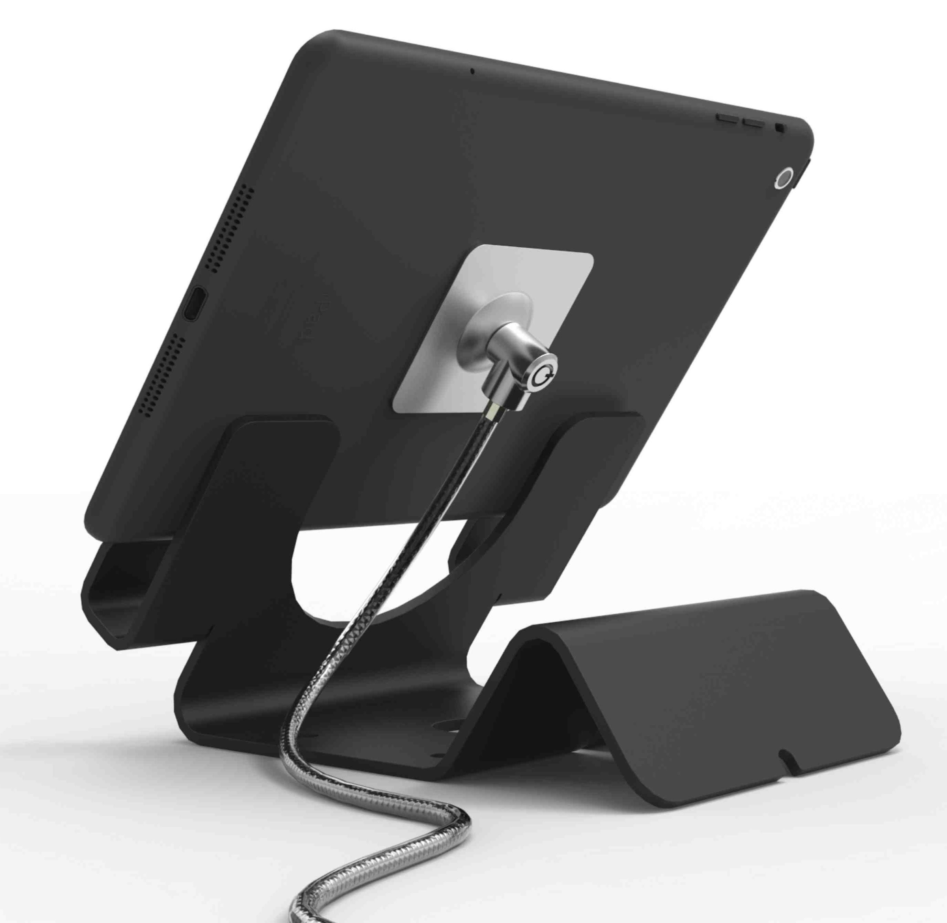
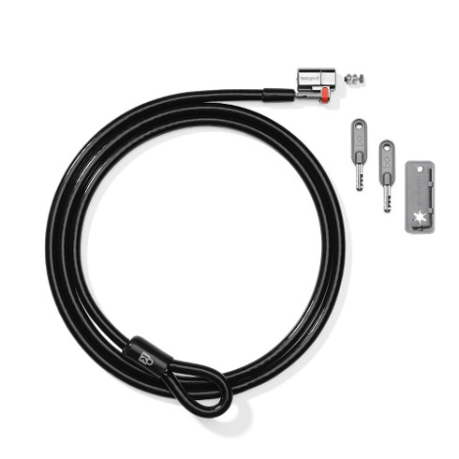
Stealing

Slide 22
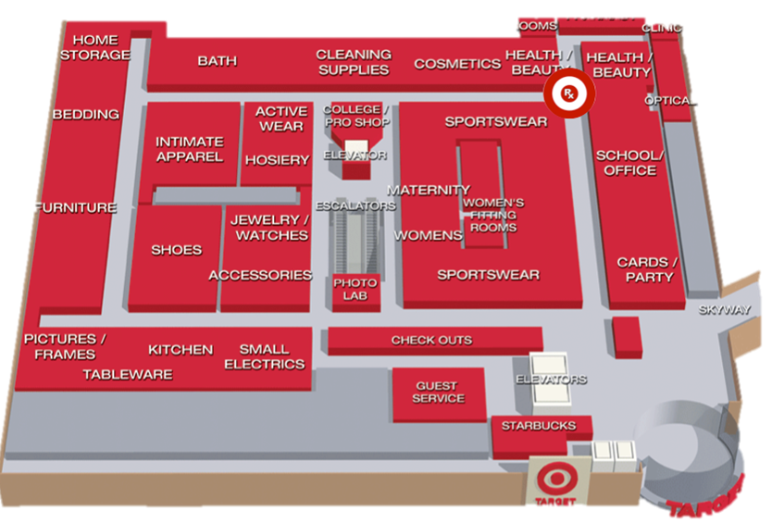
Product Placement

Slide 23
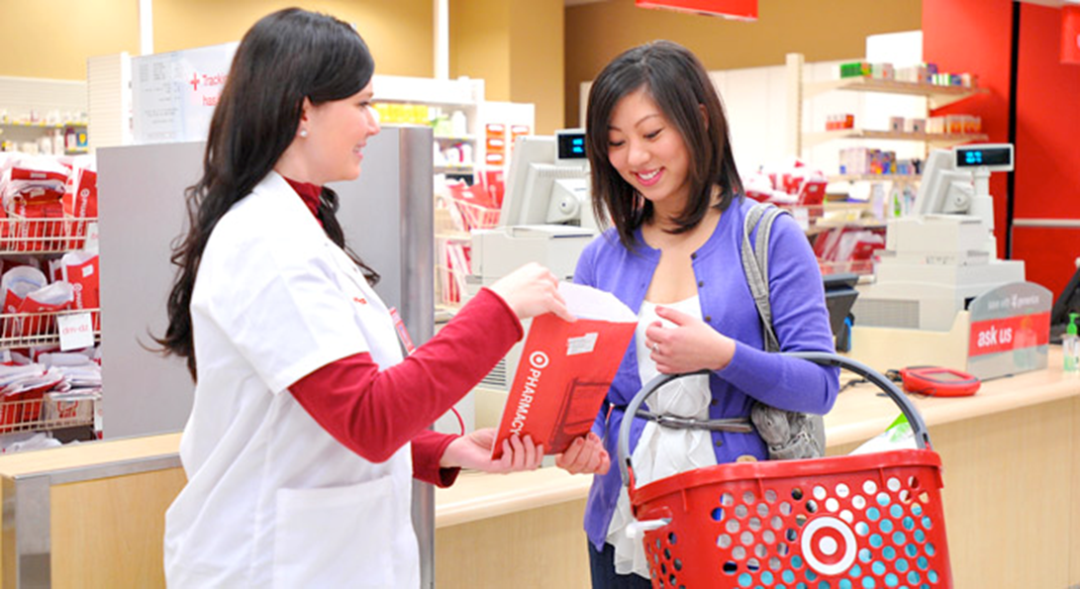
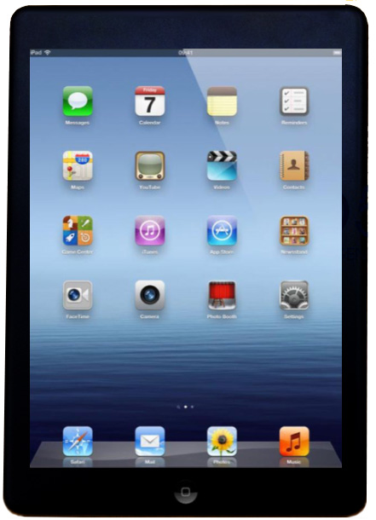
Technician + iPads
Notes:
RIS News and Cognizant survey of US and Canadian shoppers released in June 2012 reports that while older shoppers prefer store-based methods, shoppers younger than age 45 prefer digital methods of personalization.
iPads + pharmacy technician serves every age of Target guest, gives them options to pick which way of customer service they prefer

Slide 24
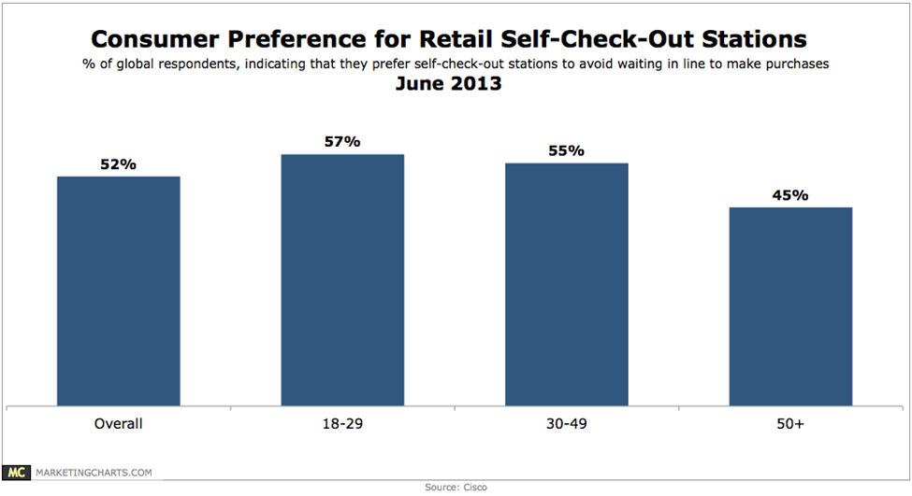
“71% of consumers want to be able to access a range of digital content while in-store. To meet that need, retailers need to be prepared to offer various mobile and touchscreen experiences.”
Notes:
According to a 2013 Cisco study of 1,069 US consumers, 47% of whom are aged 18-39. 51% are male.

Slide 25

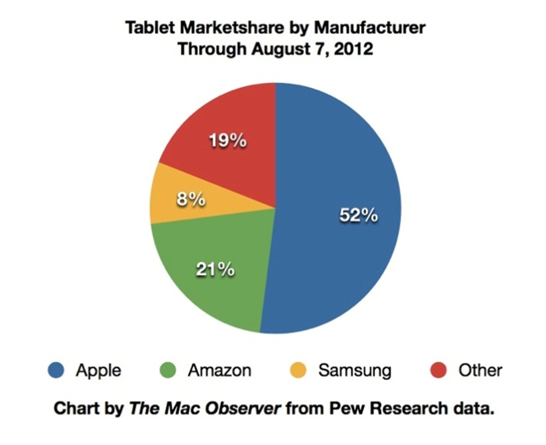
Why iPads?
Notes:
Apple holds the majority of the tablet market share, making the iPad the tablet that most guests would feel comfortable using. Target also sells the iPad within its stores, which makes it simple for Target to acquire the needed iPads for Pharma-Booth. Because Target already sells iPads in stores, it presents an opportunity for guests to purchase an iPad as well. If a guest uses an iPad for the first time at the Pharma-Booth, she may discover that she has an interest in buying one.

Slide 26
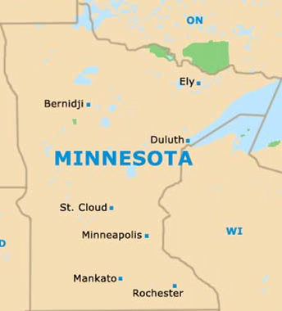
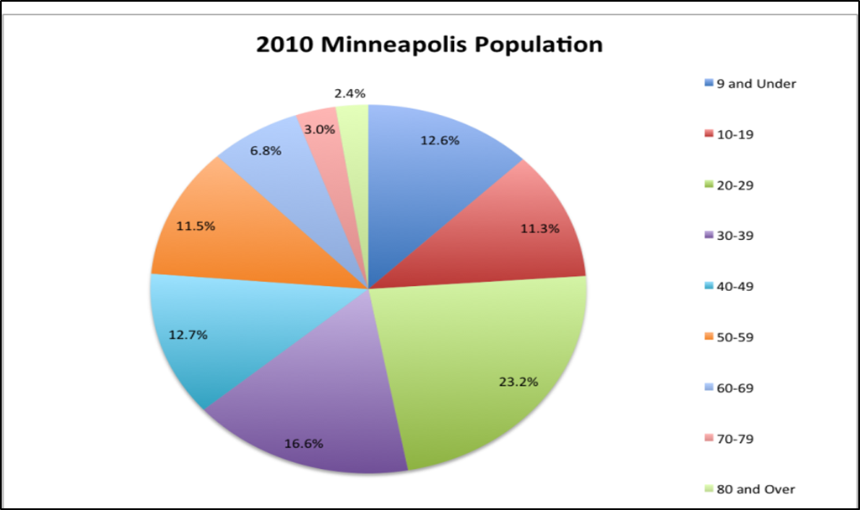

Location, Location, Location

Slide 27





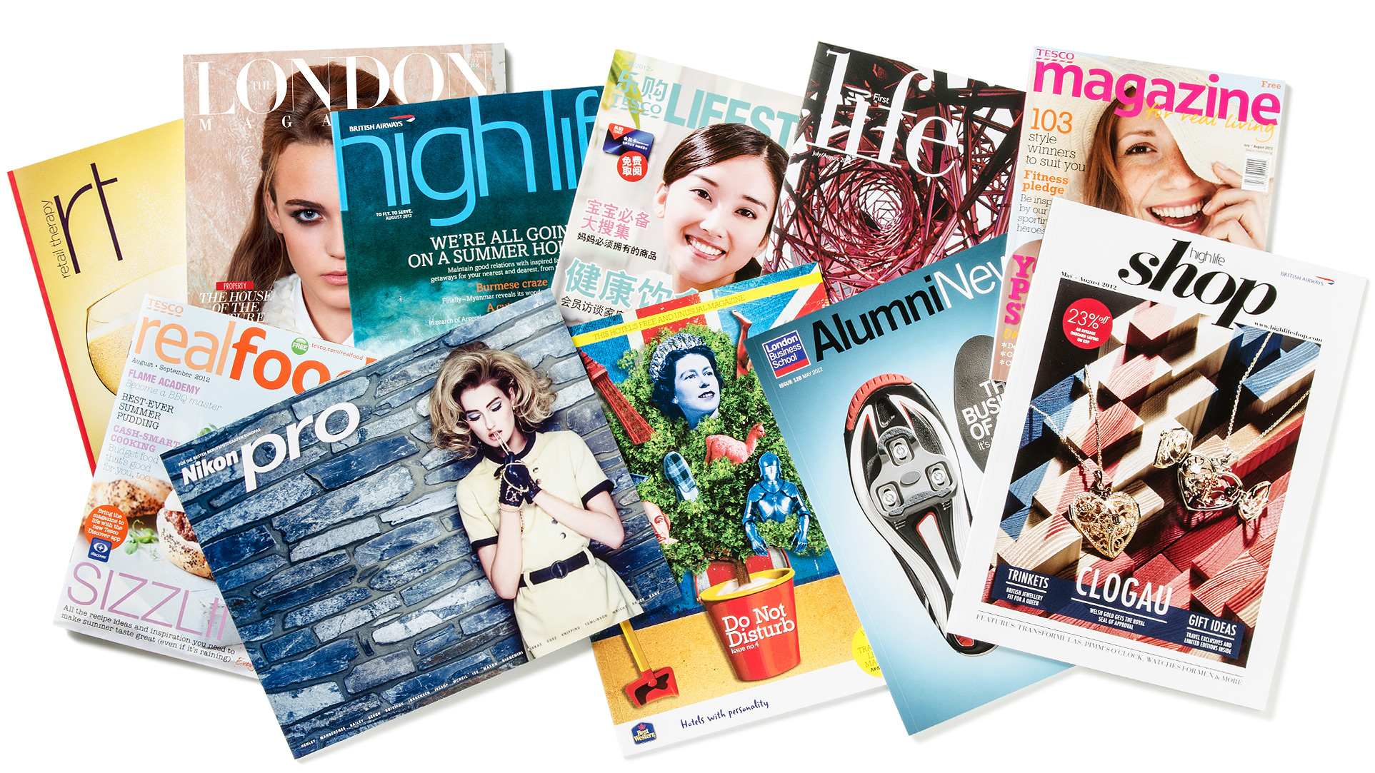
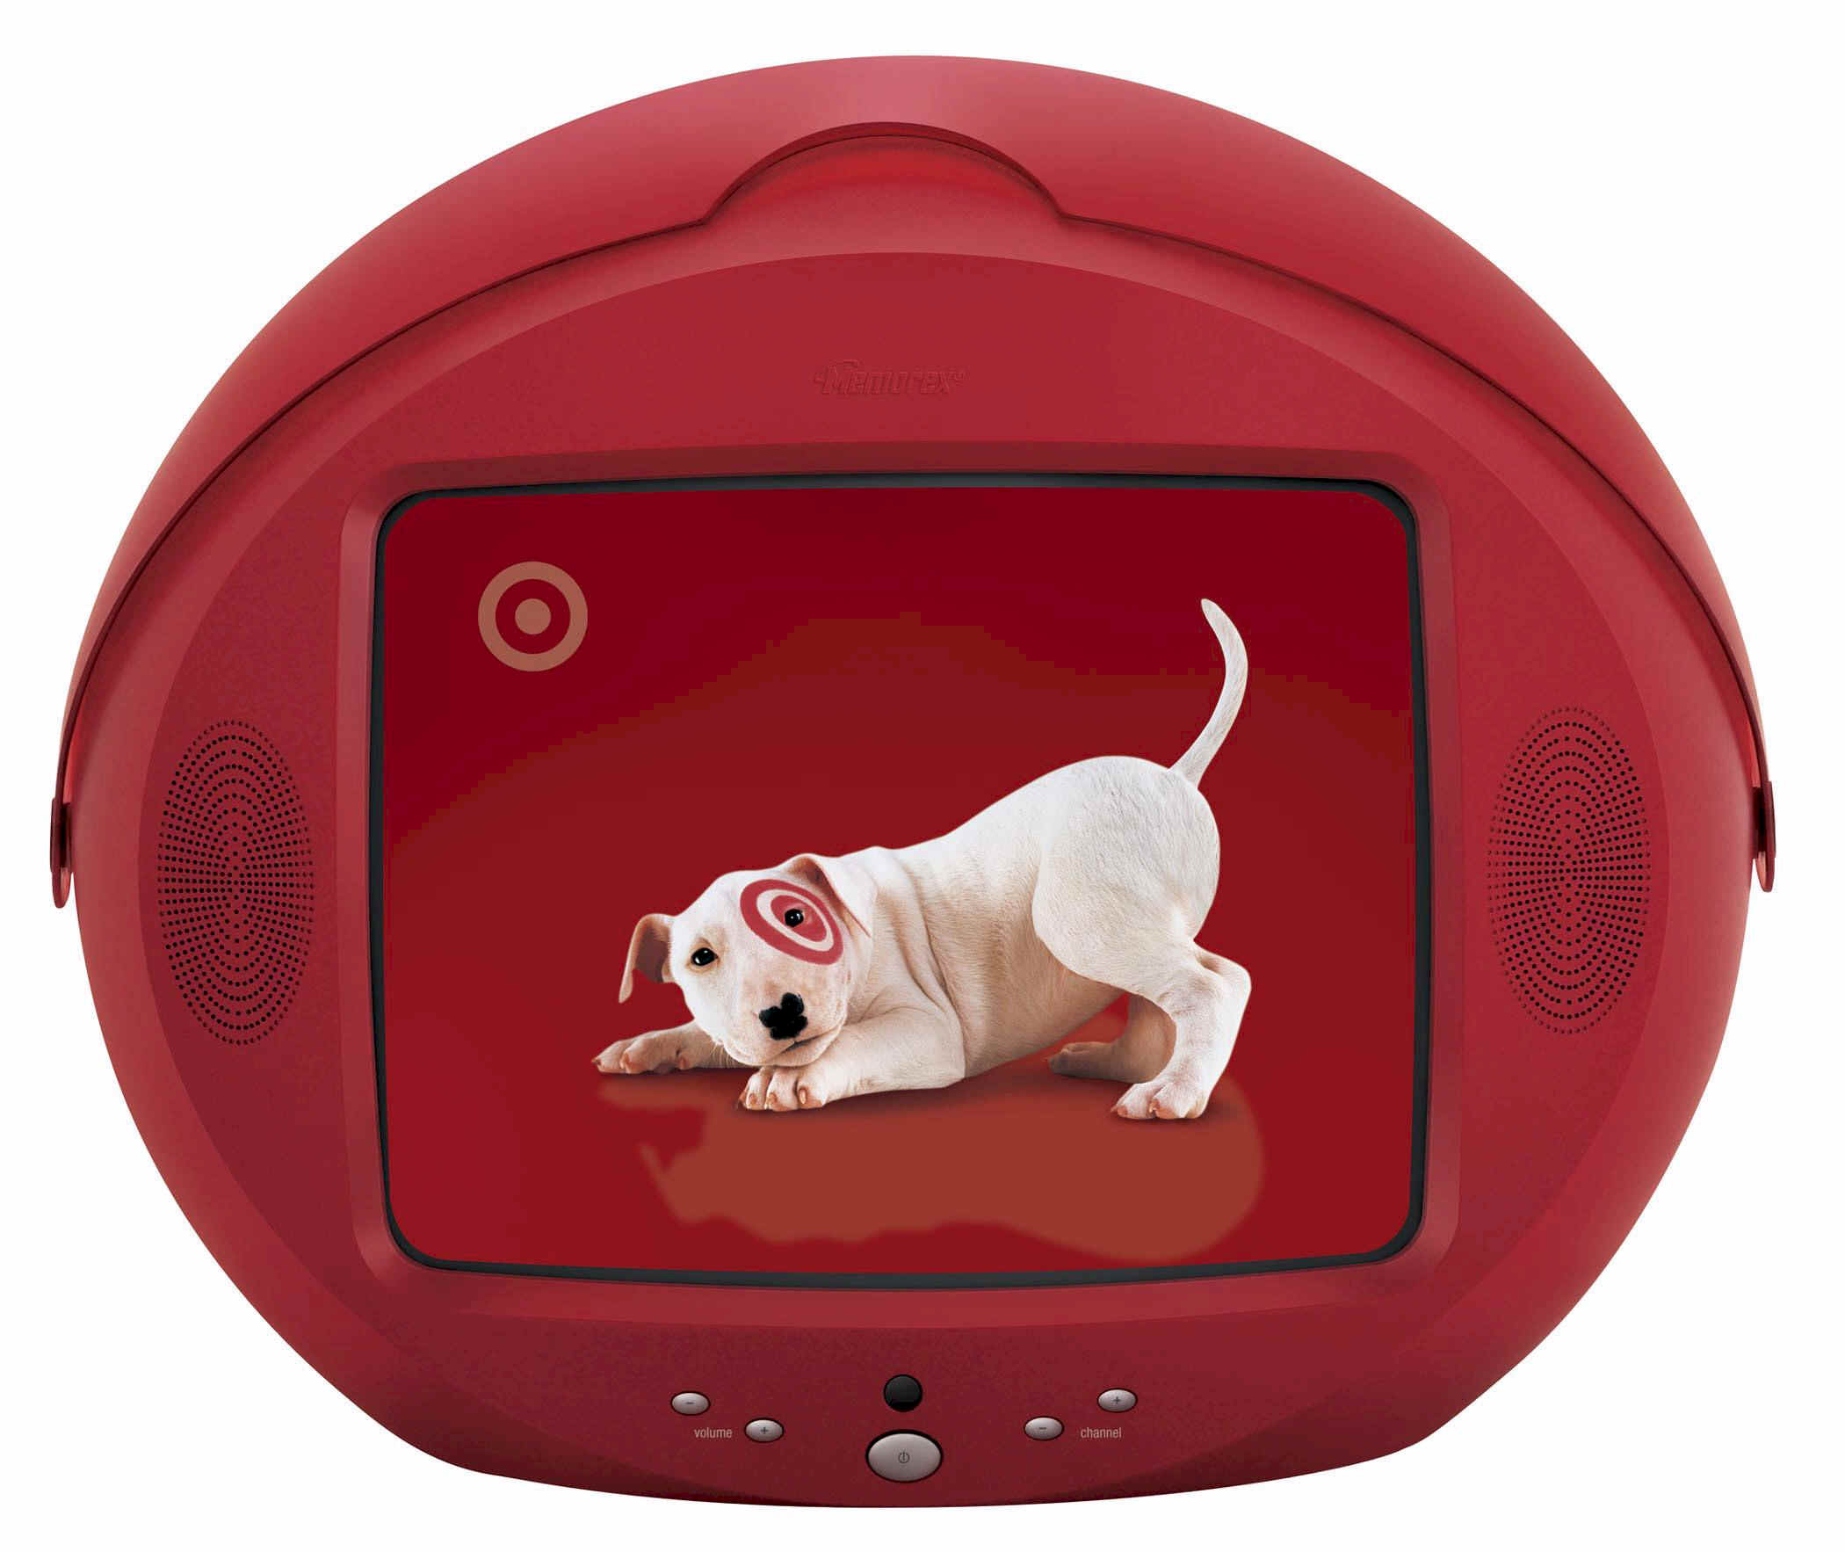
Marketing Strategies
Notes:
Currently, there is no particular marketing campaign targeted towards this unique range of guests. When analyzing Target’s pharmacy, the biggest problem was the guest’s lack of knowledge. The simplest and most affordable way to increase guest awareness would be to create a marketing campaign specifically for the Target pharmacy.
Create pharmacy specific marketing strategy
half of social media users under 35 follow their online friends product and service recommendations (social media today)
47% of Americans say Facebook has a greater affect on their purchase habits than any other social media (social media today)
50% of Twitter users are more likely to purchase brands they follow (social media today)
Baby Boomers watch the Second largest amount of TV per month, only behind traditionalists (65+) (Marketing Charts)
82% of adults aged 50+ who use the Internet research health and wellness information online (Resources - 50 facts and fiction)

